Slide 1


Root Cause Analysis for SO2 Emission in Kraft Recovery Boiler
Daniel Yung Chi Cho
Dec 6, 2018

Slide 2
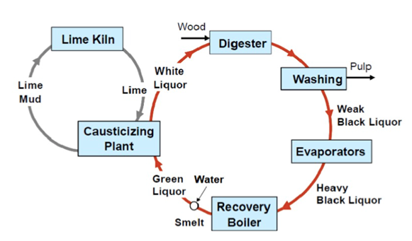
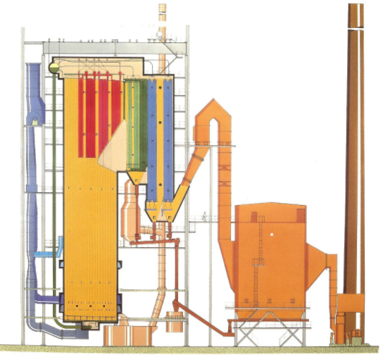
Recovery Cycle
SO₂ emission

Slide 3
Problem Statement
High sulfur dioxide emission at recovery boiler at a pulp mill.
Sulfur dioxide is a regulated pollutant.
Company faces penalty for emission beyond the limit.
Finding the root cause for sulfur dioxide emission based on historical data.
Objective
Notes:
Relate the objective to his lecture: explaining the past and predicting the future

Slide 4
Data Source and Variables
Source: hourly process data from March 2016 to June 2016 provided by an industrial partner.
Data Type: Numerical
Variables: 26
Observations: 2327
BL Density Dry Solids-B | Time Stamp
Primary Air Temp. | Primary Air Flow
Secondary Air Temp. | Secondary Air Flow
Steam Flow | Tertiary Air Flow
Liquor Solids Flow | Primary Windbox Pressure
ST/DS Ratio | Secondary Windbox Pressure
SO2 Raw (1min Avg.) | Tertiary Windbox Pressure
SO2 Raw (1Hr Avg.) | Burn Rate
Black Liquor Press | Sulfidity Calculated
BL Indirect Heater Temp. | BL Solid 50/50 Test
Salt Cake Rotary Feeder Sp. | Flue Gas Oxygen
Lime Kiln Entry | TRSRAW 1 Min Avg.
Nox (1Hr Avg.) | BL Density Dry Solids-A

Slide 5
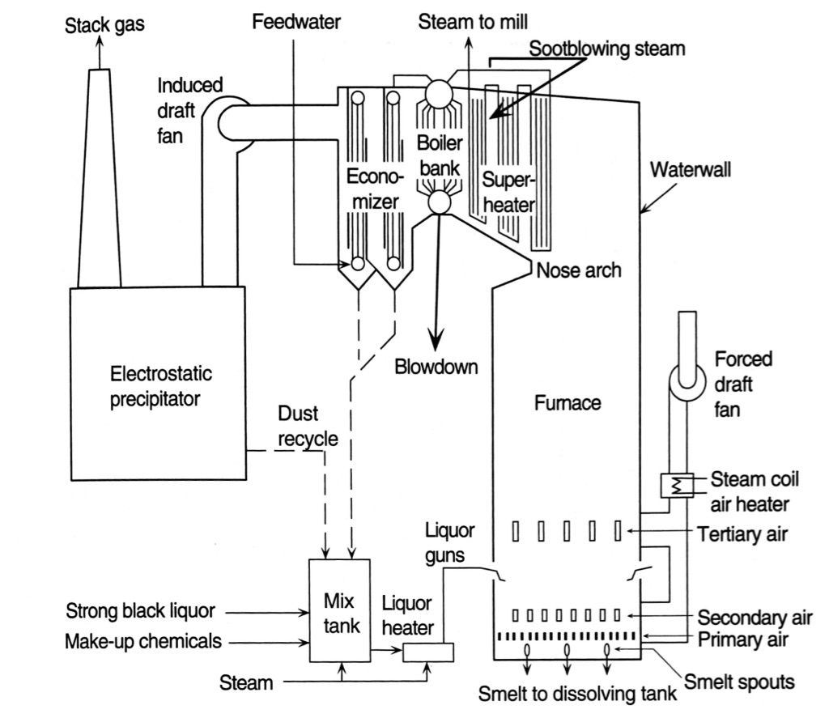
Recovery Boiler schematics
F, S/DS
SO2 Hour Average
SO2 Minute Average
Oxygen
Nox
F,P
BR
Density (sensors, lab)
Sulfidity
F, T
T
F, T,P
F
F, T,P
Sulfidity

Slide 6
Simplify
Black Liquor & Air
Boiler
Flue Gas
Steam
Green liquor

Slide 7
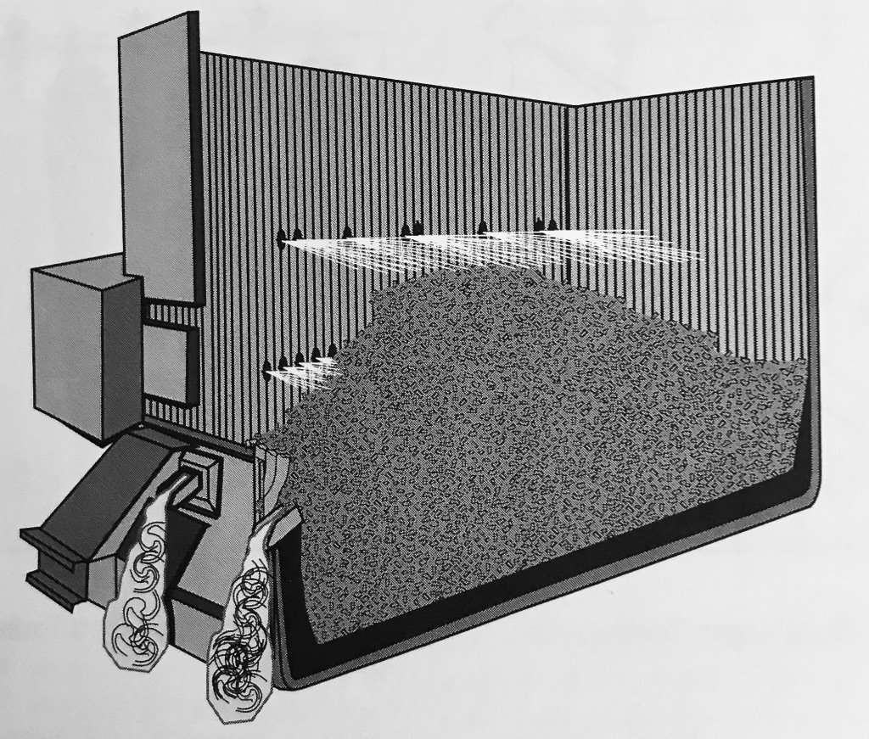
Inside the Recovery boiler

Slide 8
Exploratory Analysis
Correlation Map, High Density plot, Compression Test, Quantification Test

Slide 9
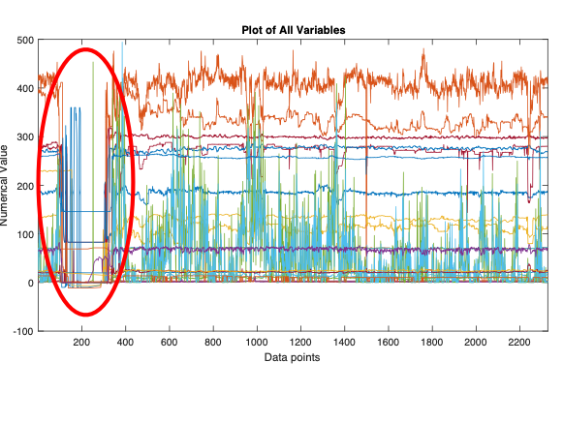

Slide 10
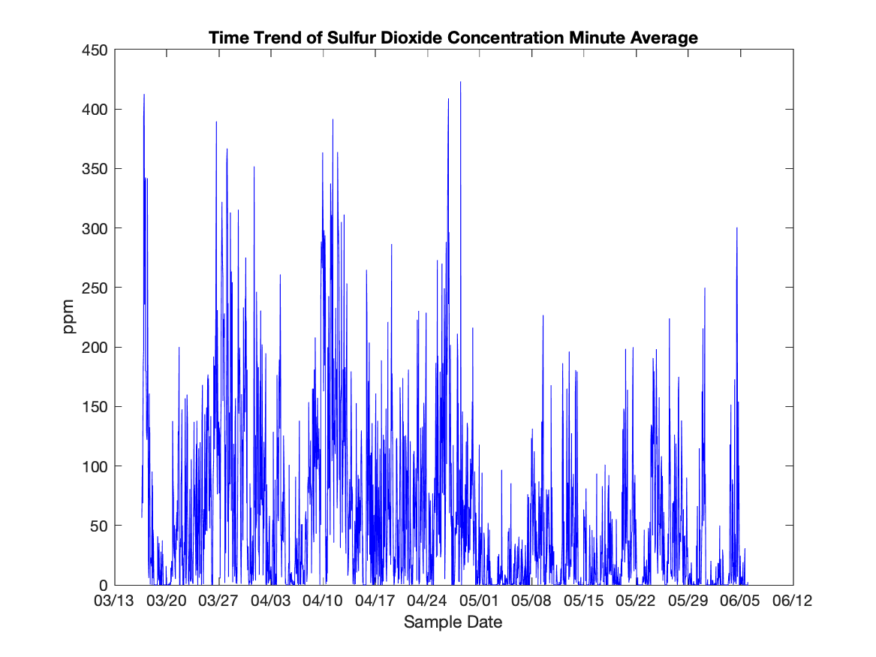

Slide 11
Correlations between independent variables and SO₂ emissions
Cor. | Parameter | Cor. | Parameter
0.084 | TRSRAW 1 Min Avg. | 0.055 | Primary Air Flow
-0.153 | BL Density Dry Solids-A | 0.0049 | Secondary Air Flow
-0.180 | BL Density Dry Solids-B | -0.127 | Tertiary Air Flow
0.113 | Primary Air Temp. | 0.0556 | Primary Windbox Pressure
0.115 | Secondary Air Temp. | 0.119 | Secondary Windbox Pressure
0.025 | Steam Flow | 0.133 | Tertiary Windbox Pressure
-0.315 | Liquor Solids Flow | 0.0576 | BL Solid 50/50 Test
0.021 | ST/DS Ratio | -0.131 | Flue Gas Oxygen

Slide 12
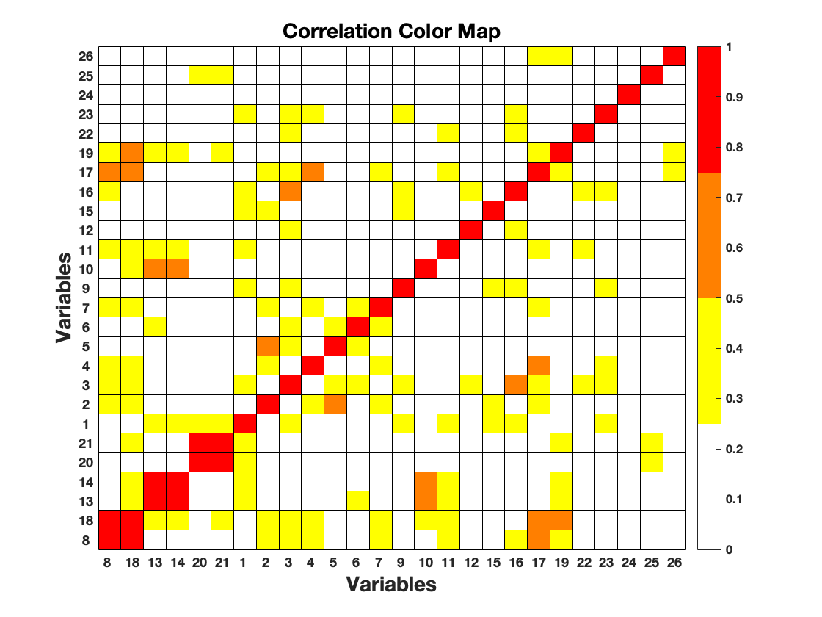

Slide 13
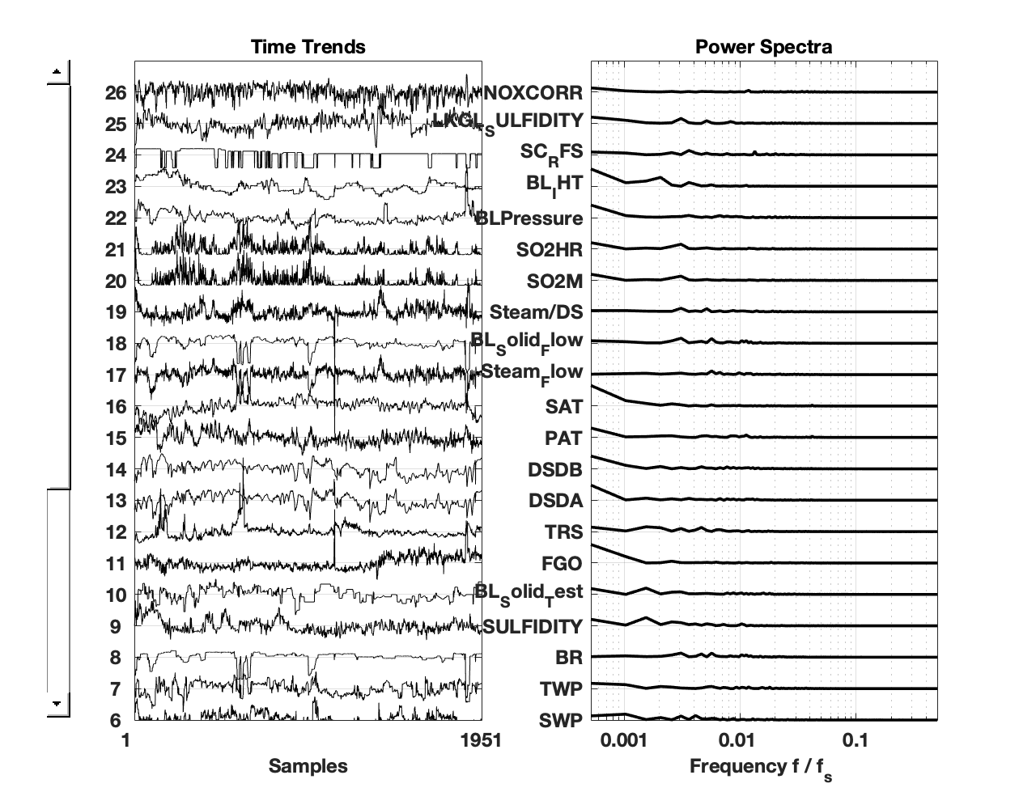

Slide 14
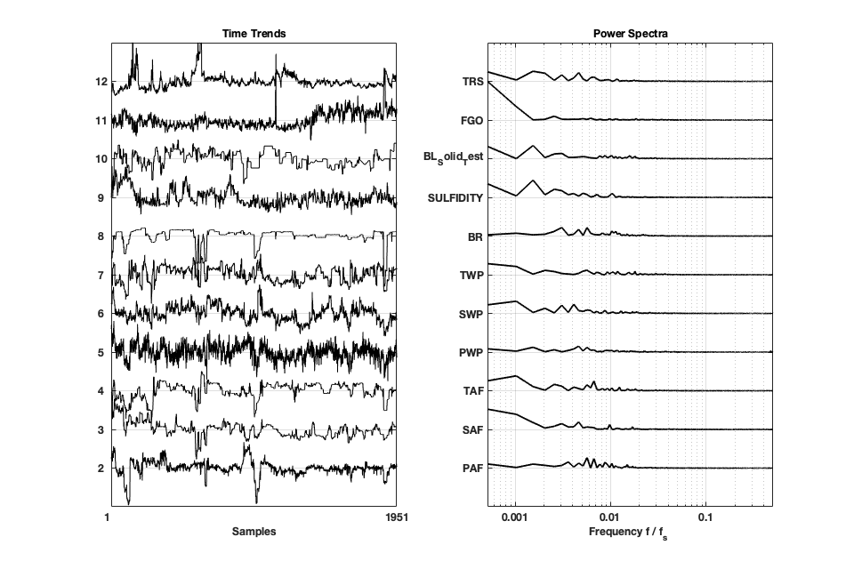

Slide 15
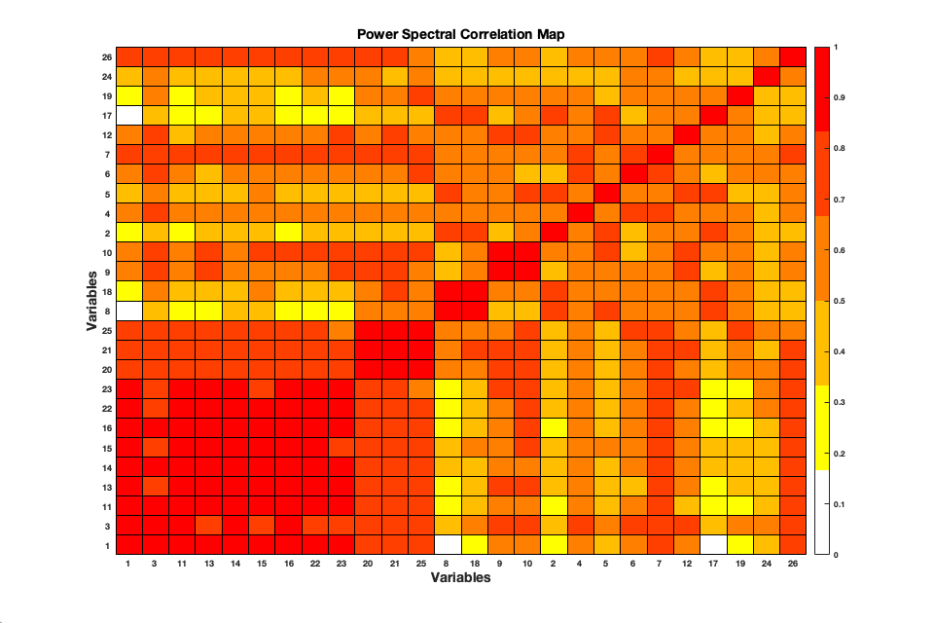
Spectral Correlation
Secondary Air Flow (Tag 3)
Flue Gas Oxygen (Tag11)
Dry Solid Density Transmitter A & B (Tag 13,14)
Primary Air Temperature (Tag 15)
Secondary Air Temperature (Tag 16)
Black Liquor Pressure (Tag 22), Black Liquor Indirect Heater Temperature (Tag 23)
Green Liquor Sulfidity (tag 25)
and NOX Correlation (Tag 26)

Slide 16
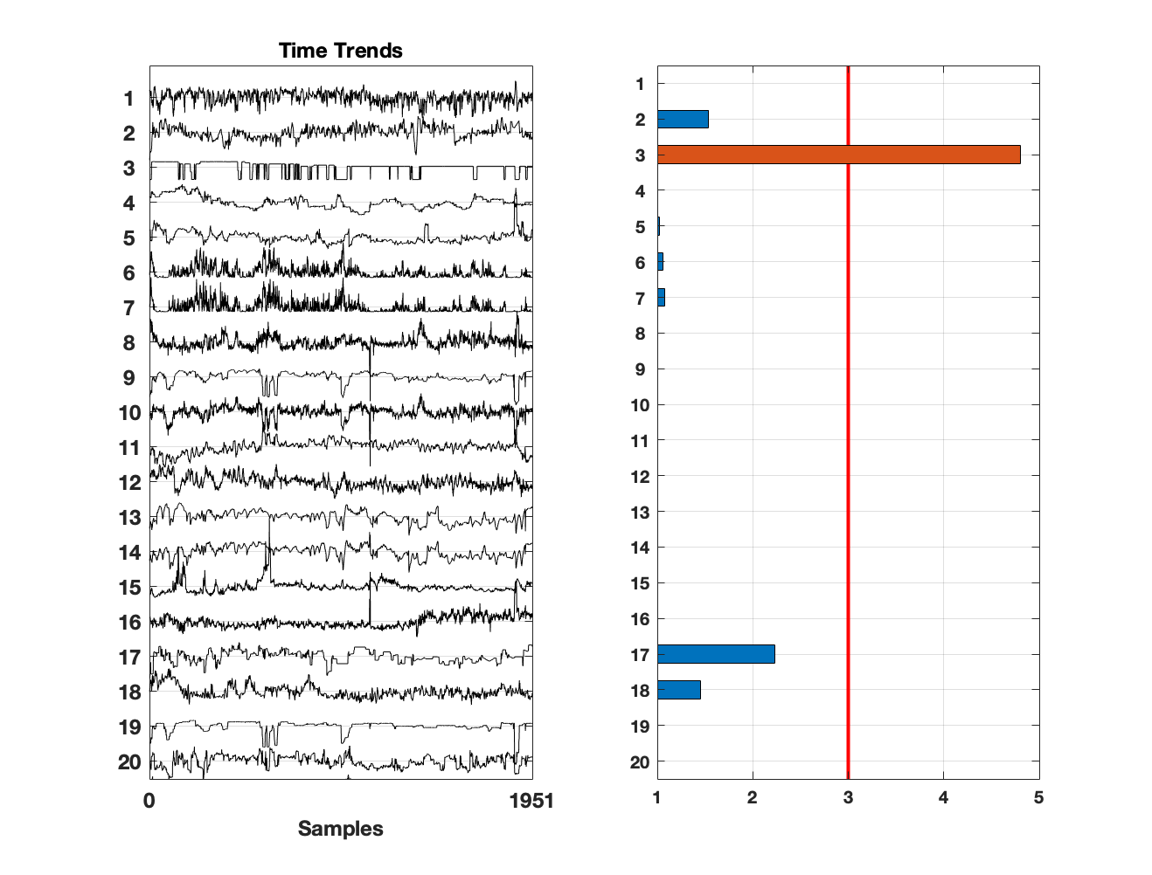
Compression Test
Secondary Air Flow

Slide 17
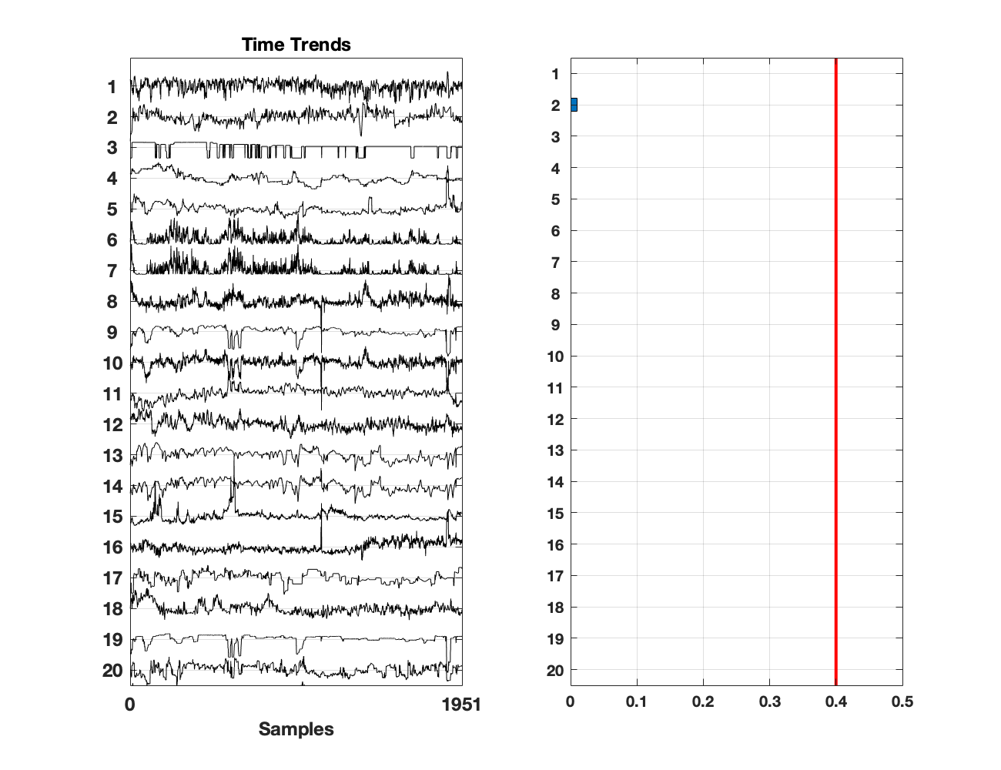
Quantization Test

Slide 18
Pre-Processing
Outliner, Transformation, lag adjustment, MA filter, Normalization

Slide 19
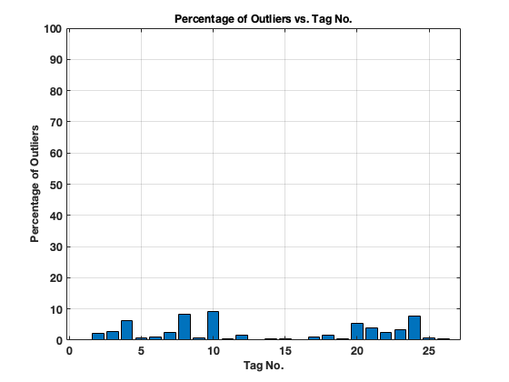
Outlier Treatment Using DVA tool

Slide 20
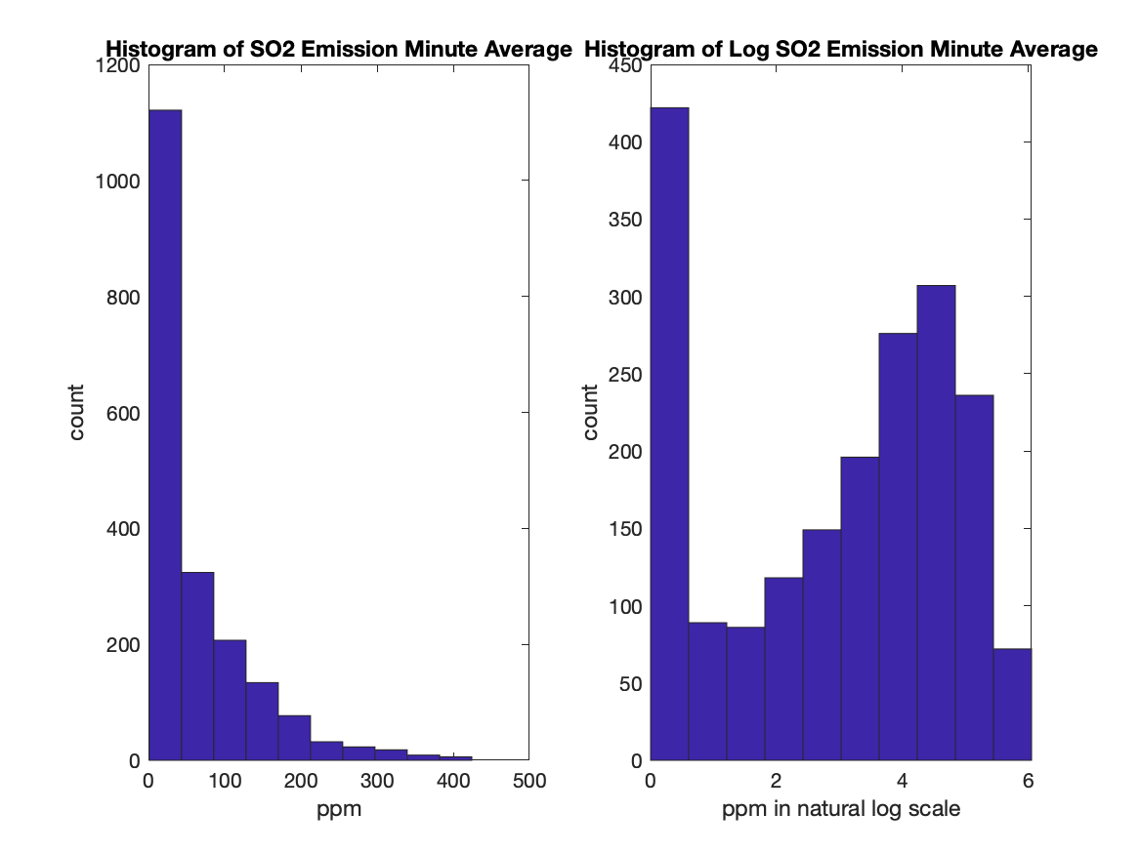
Log Transformation of SO2 Emission

Slide 21
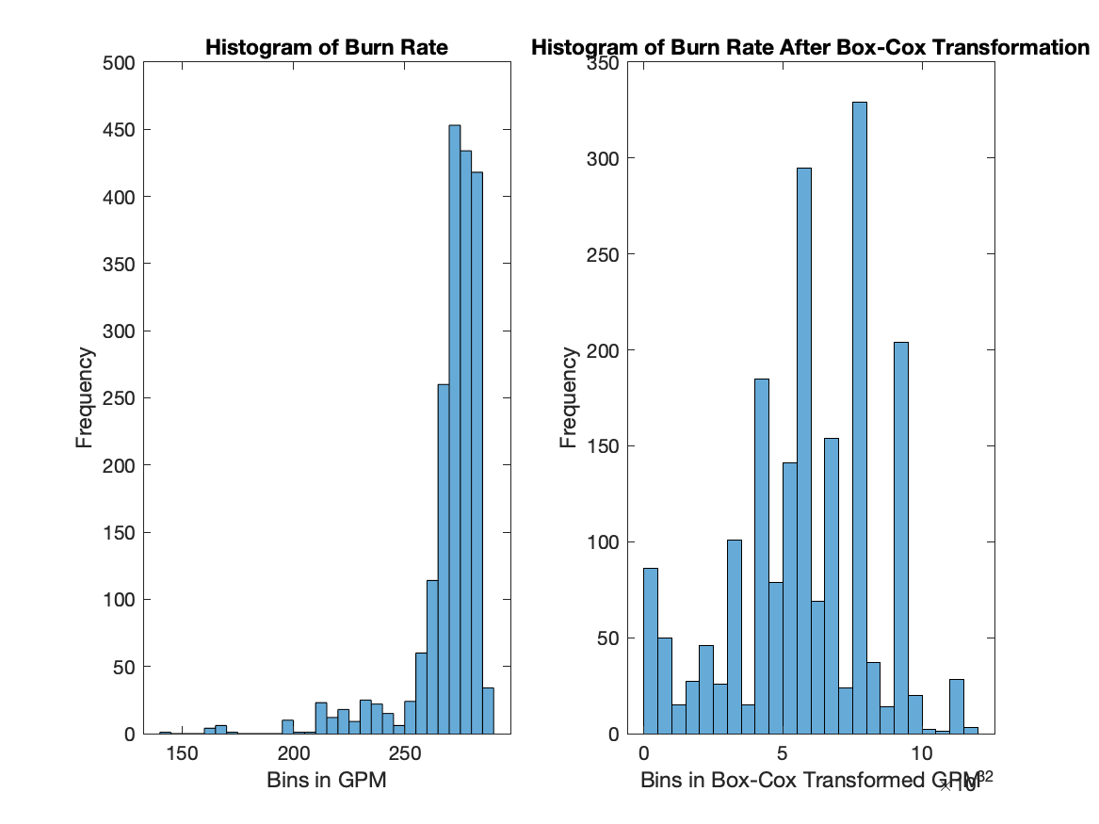
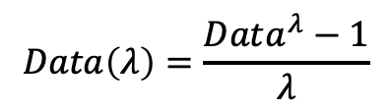
Box-Cox Transformation of burn rate
Definition of Box-Cox
$$Data\left(λ\right)=\frac{Data^{λ}−1}{λ}$$

Slide 22
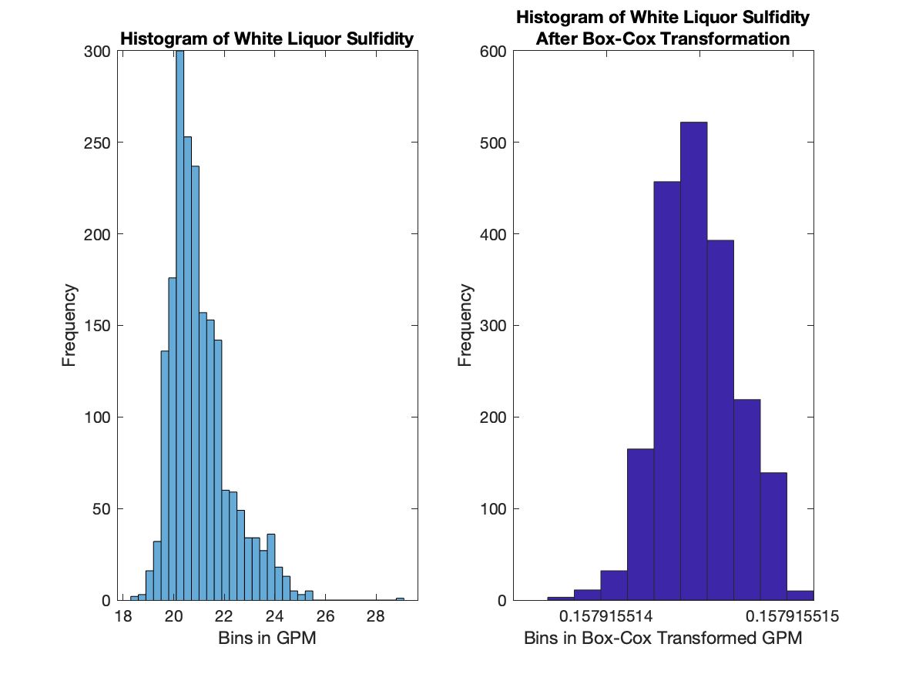
Box-Cox Transformation of Sulfidity

Slide 23
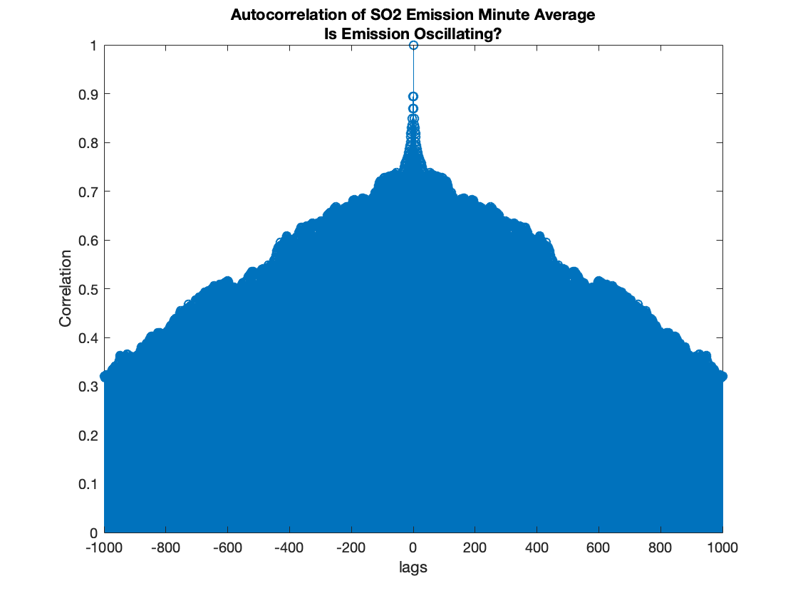
Is Emission Oscillating?

Slide 24
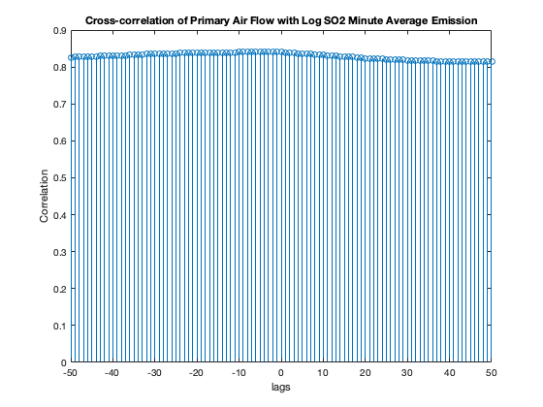
Cross-correlation for all variables with SO2
Max

Slide 25
Lag time found by maximizing Cross-Correlation
Variables | Lag time with Log
Time stamp | 0
PAF | -5
SAF | -5
TAF | -9
PWP | -5
SWP | 0
TWP | -26
BR | -10
Sulfidity | -1
BL_Solid_Test | -9
FGO | -21
TRS | -30
DSDA | -10
Variables | Lag time
DSDB | -10
PAT | 0
SAT | 0
Steam_Flow | -2
BL_Solid_Flow | -10
Steam/DS | -2
SO2M | 0
SO2HR | -1
BLPressure | -10
BL_IHT | 0
SC_RFS | -34
LKGL_SULFIDITY | -9
NOXCORR | -15

Slide 26
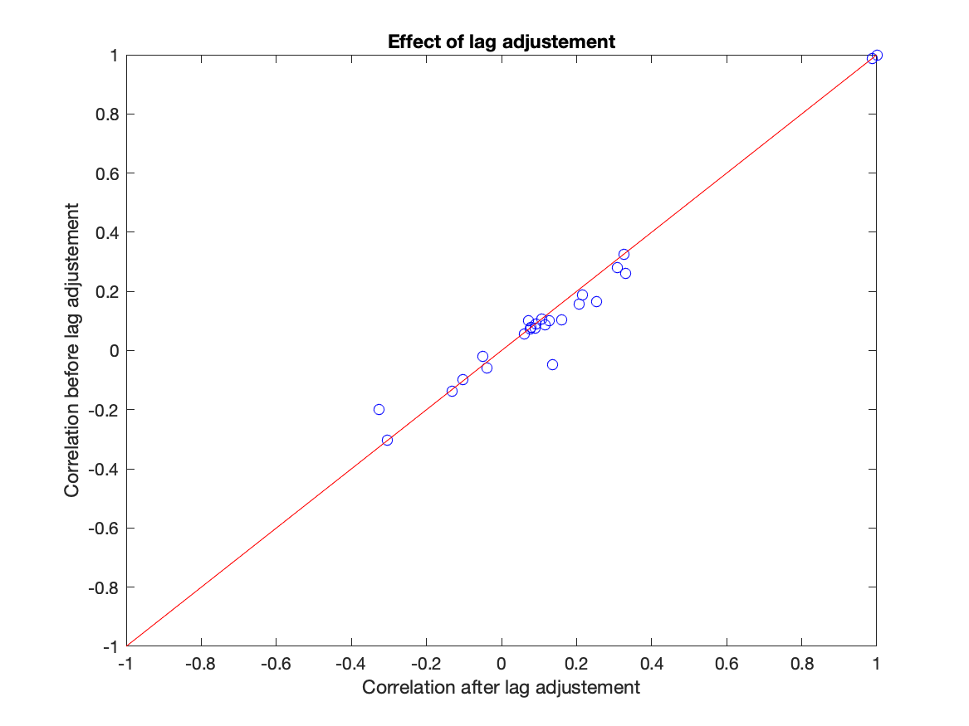
Effect of Lag adjustment Changes in Correlation with SO2 emission

Slide 27
Lag adjustment
 | Var1 | Var2 | Var 3 | Var 4
t

Slide 28
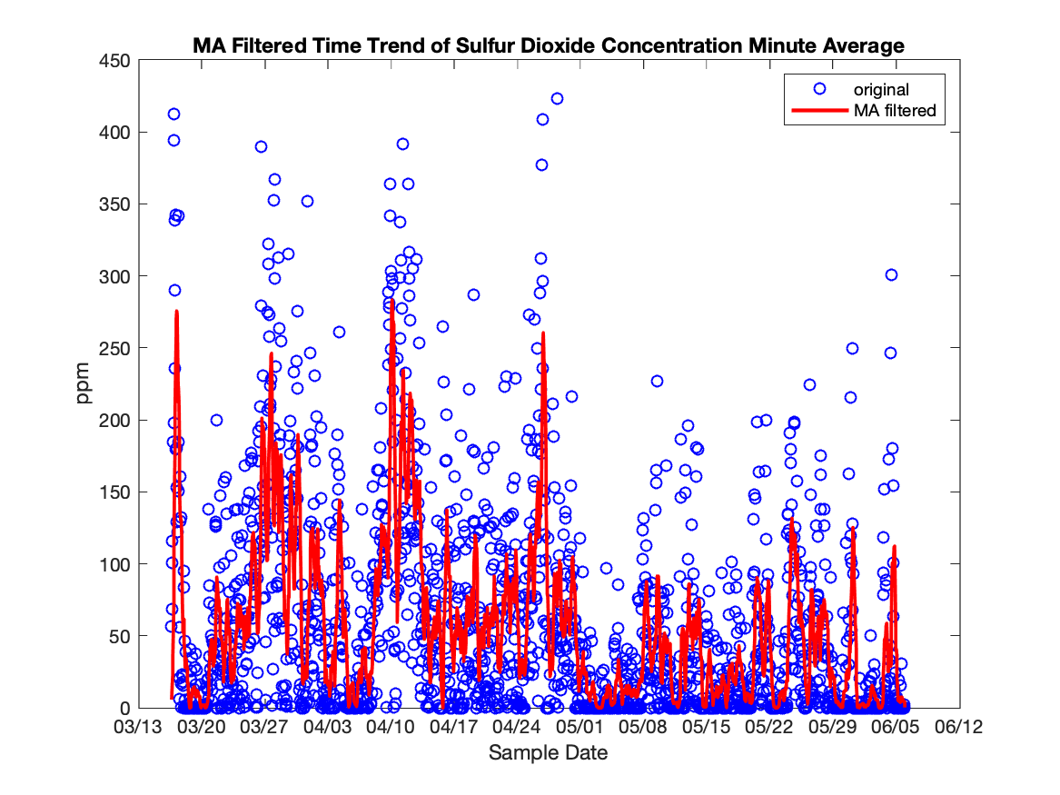
Moving Average filter
Window size = 20

Slide 29
Normalization
Data are normalized and centered to balance the scale of the variables and make variance comparable.

Slide 30
Creation of training and test set
Training set and test set were created using random sampling without replacement.
1366 records goes to training and 585 records goes to testing

Slide 31
Training and Testing
OLS, PCR,PLS, Regression Trees

Slide 32
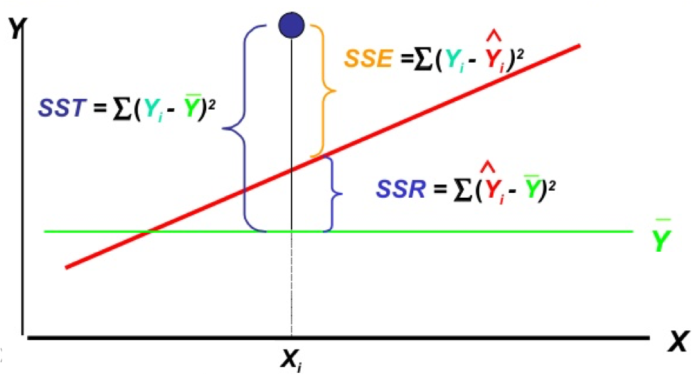
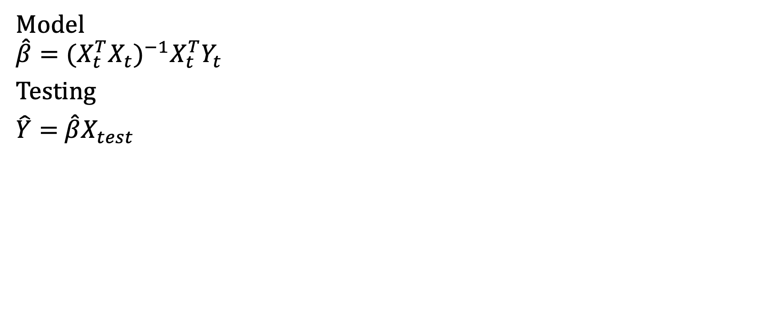
Ordinary Least Square Regression
Model
$${\hat{β}=(X_{t}^{T}X_{t})}^{−1}X_{t}^{T}Y_{t}$$
Testing
$\hat{Y}=$ $\hat{β}X_{test}$

Slide 33
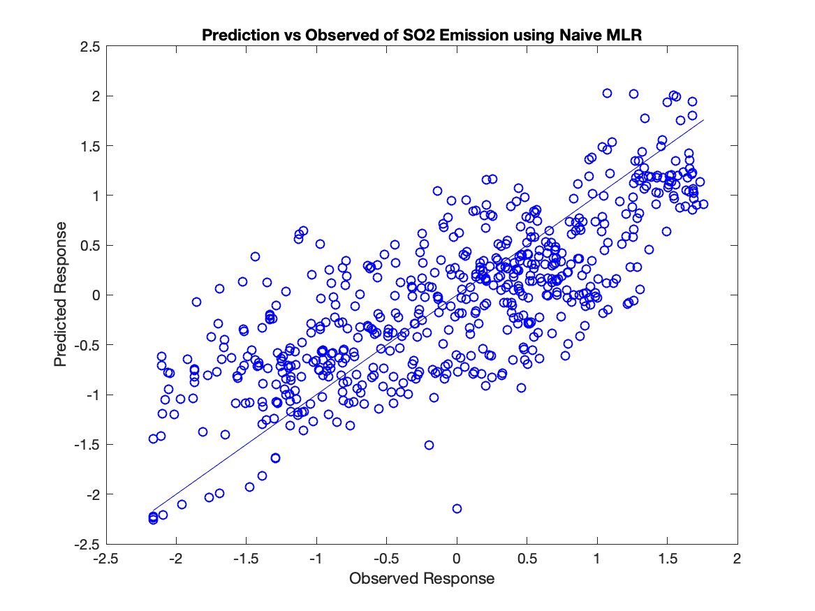
Ordinary Least Square Testing
Regress with all 23 variables
SSE is 237.8710
RMSE was 0.6512
R² is 0.5866.
Notes:
Linear model assumes data is normally distributed with mean equal to mu and standard deviation equal to sigma.

Slide 34
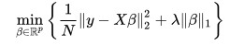
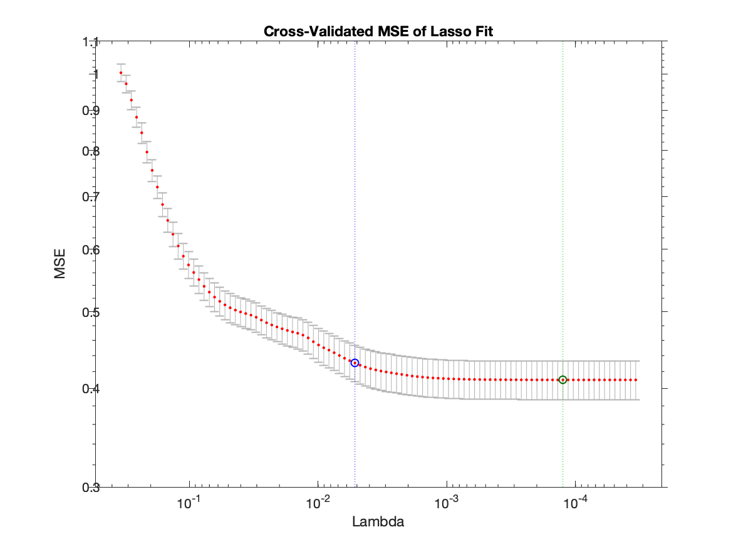
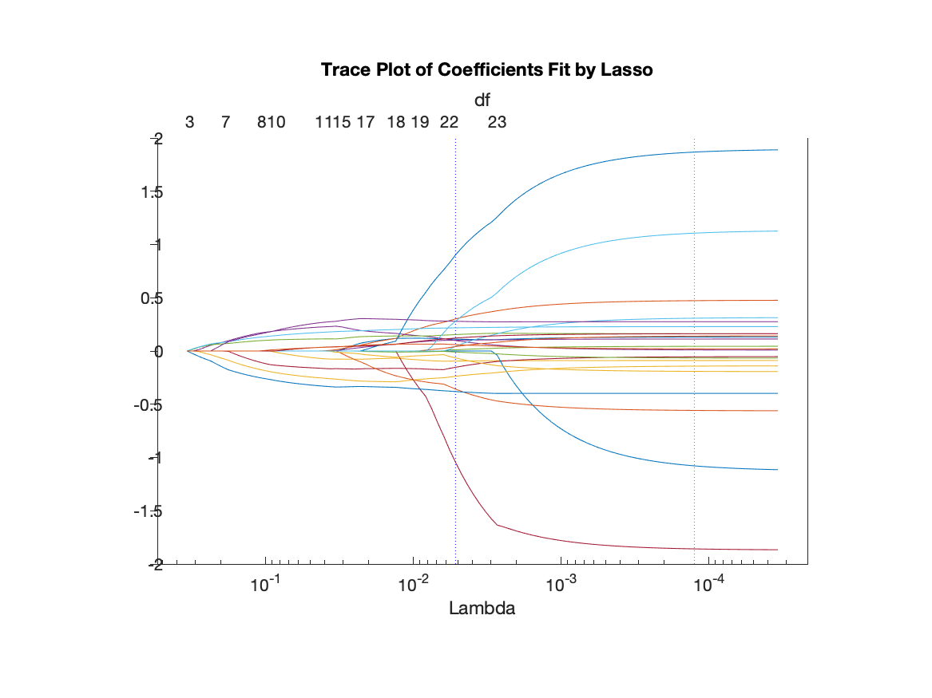
LASSO
Objective Function

Slide 35
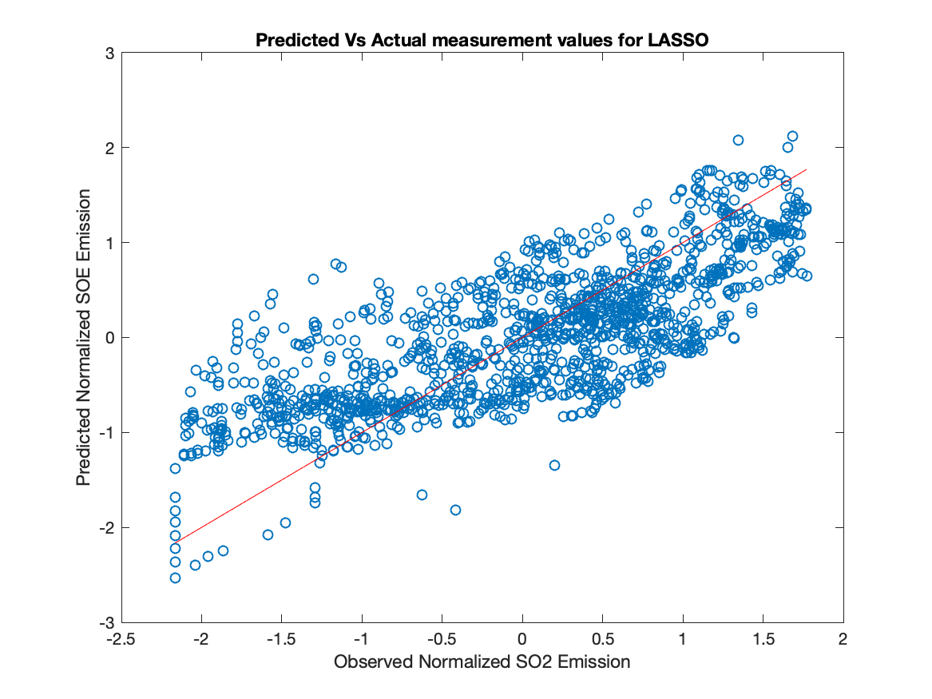
Testing LASSO
Regress with all except Sulfidity
RSS = 251.8956
RSE = 0.6695
Rsq = 0.5623

Slide 36
Principle Component Analysis
Dimension reduction by creating latent variables that are linear combination of the original variables.
PCA finds efficient ways to describe data with less variable and with minimum data loss

Slide 37
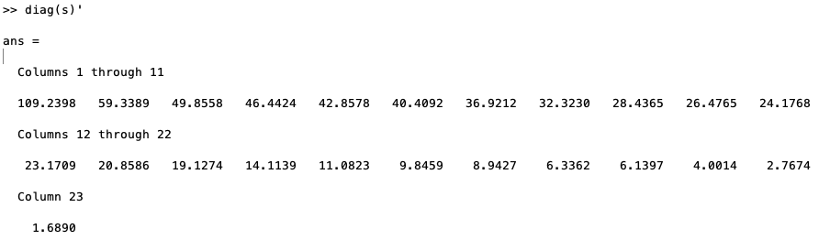
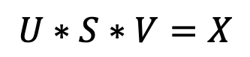
Single value Decomposition
$$U∗S∗V=X$$
Notes:
S is the square-root of the eiganvalues for X transpose X matrix.
The diagonal of s is the covariance for each principle components
US = XV(inverse)
US is score matrix
V is loading matrix

Slide 38
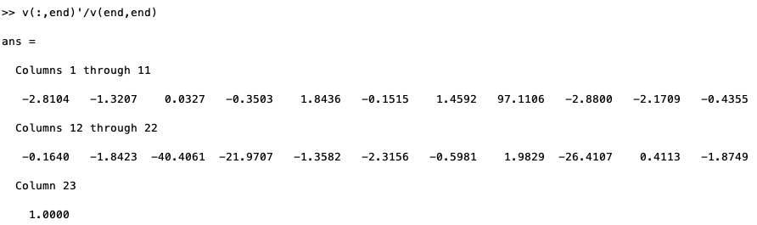
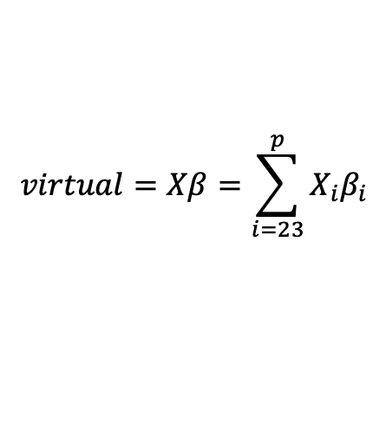
Virtual Variable
$$virtual=Xβ=\sum_{i=23}^{p}{X_{i}β_{i}}$$

Slide 39
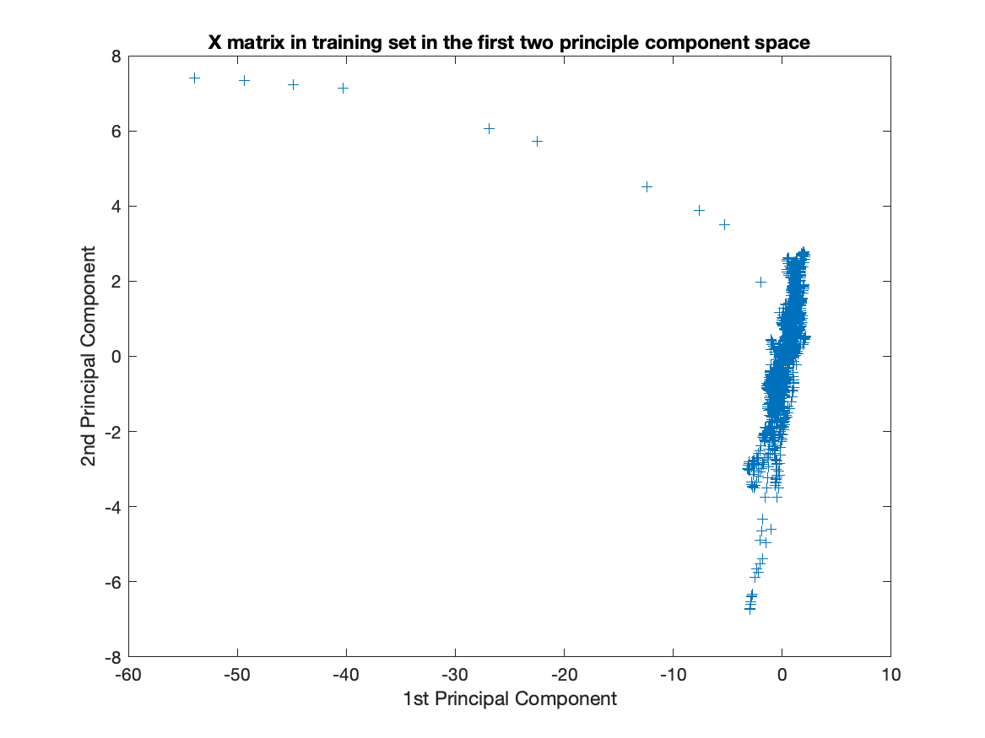
X training data in the first two principle component space

Slide 40
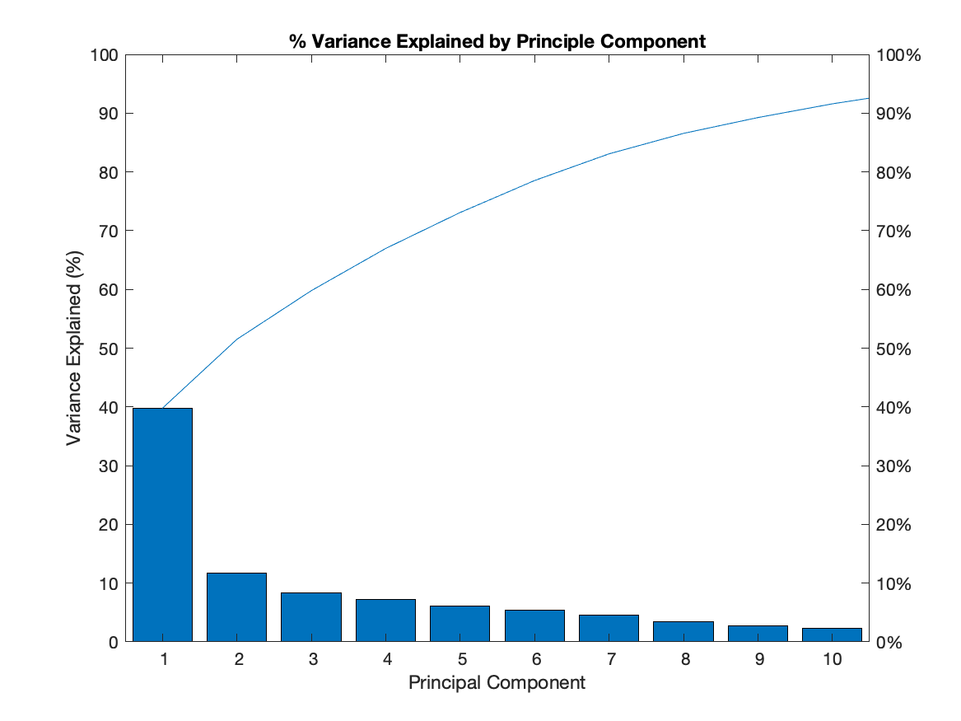
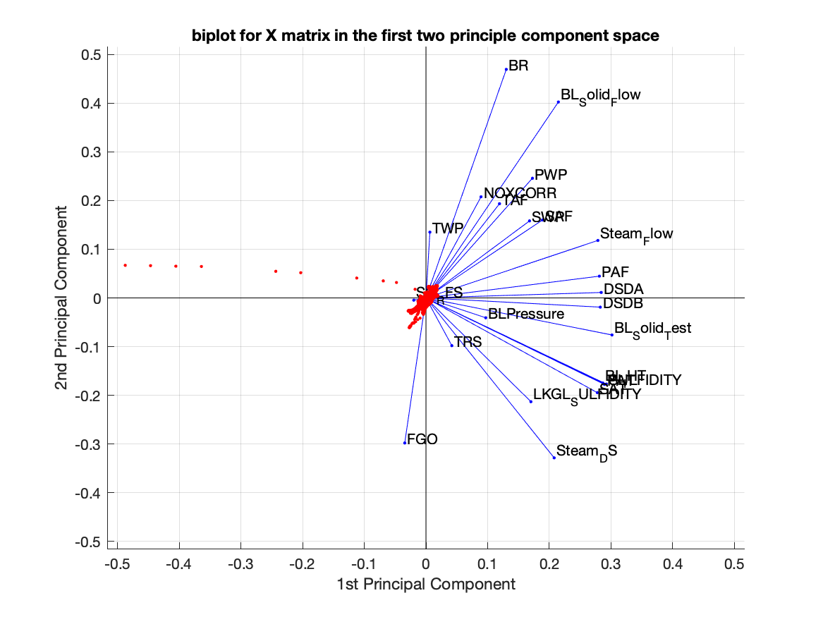
Variance explained by principle components

Slide 41
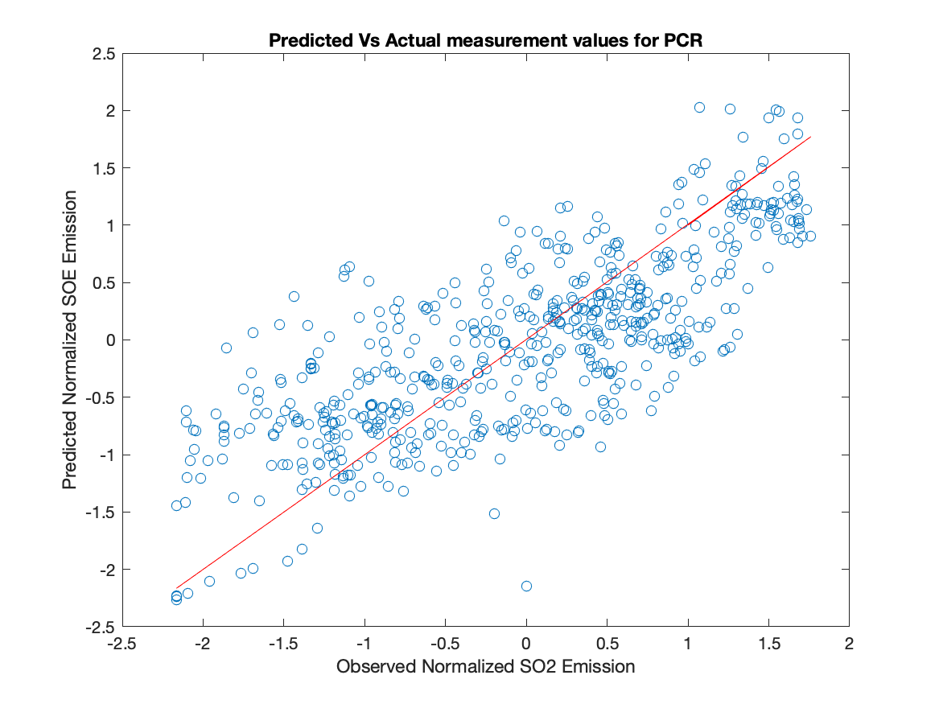
Principle Component Regression
Regression with all variables
SSE is 237.87
RMSE is 0.6512
Rsq = 0.5866
Identical to OLS when regressing all variables

Slide 42
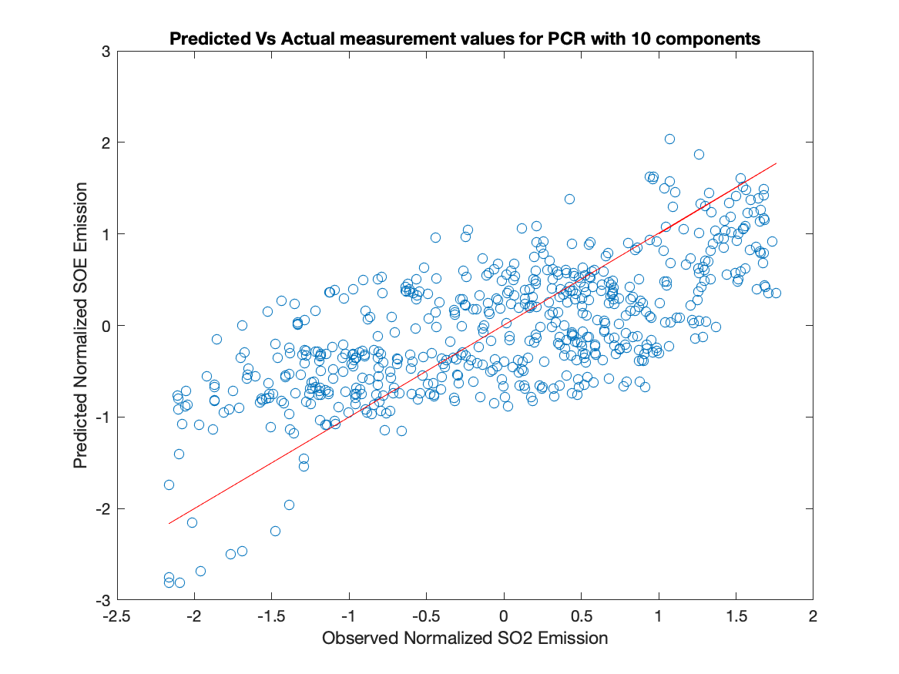
Principle Component Regression
Regress with top 10 components
SSE = 304.6549
RMSE = 0.7369
R-sq = 0.4706
Over estimated in the low end and underestimated in the high end

Slide 43
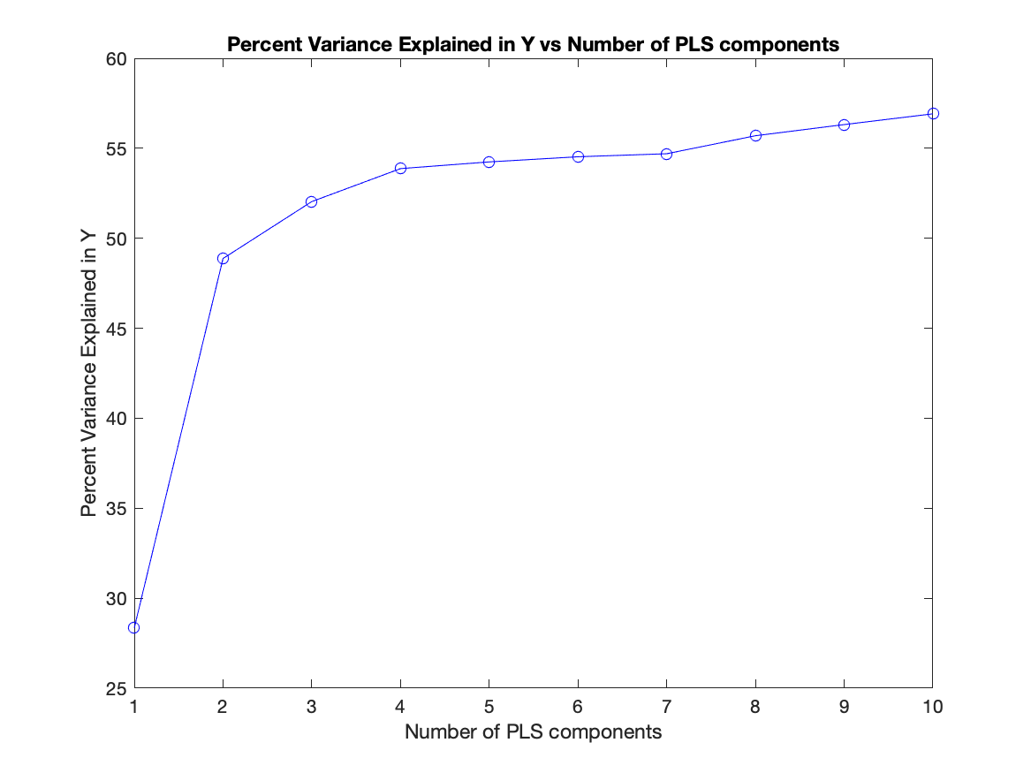
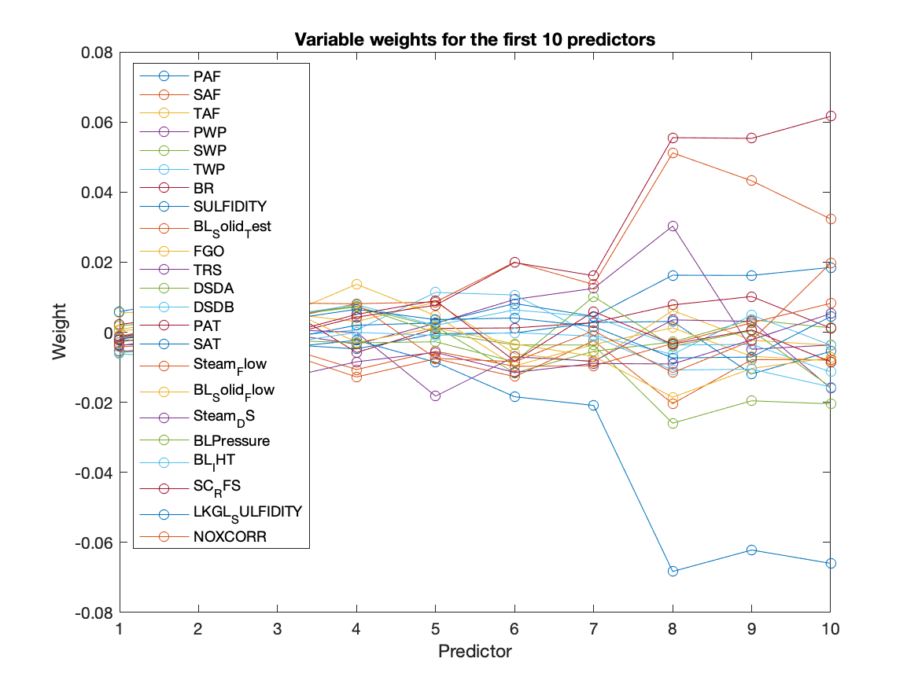
Partial Least Square
Notes:
Convert the Multiple Input Multiple Output (MIMO) regression problem into a series of Single Input Single Output (SISO) regression problems.
Performs projection to latent variables like PCA but also consider Y. PLS was performed using 10 fold cross validation.

Slide 44
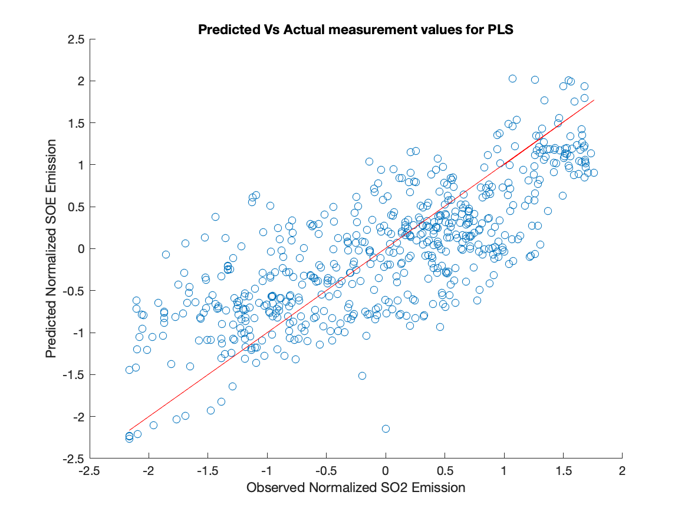
Partial Least Square Testing
Regress with to 10 components & 10 fold crossvalidation
SSE = 257.56
RMSE = 0.66
R square = 0.55
Same accuracy as OLS with fewer components

Slide 45
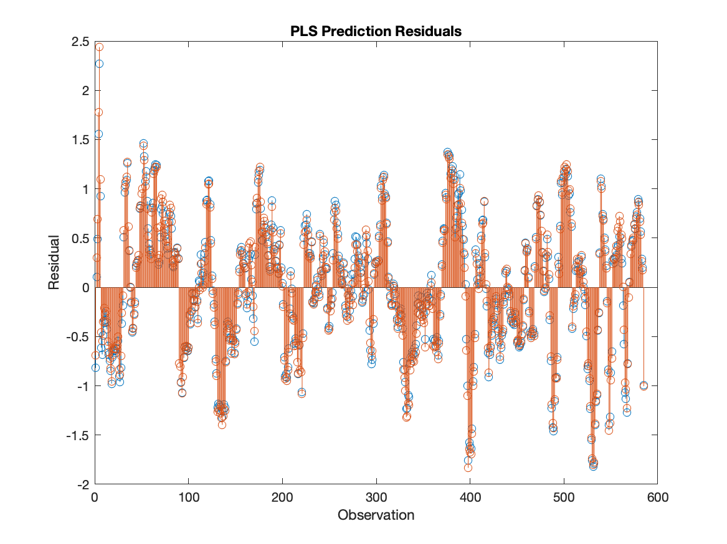
PLS Residuals

Slide 46
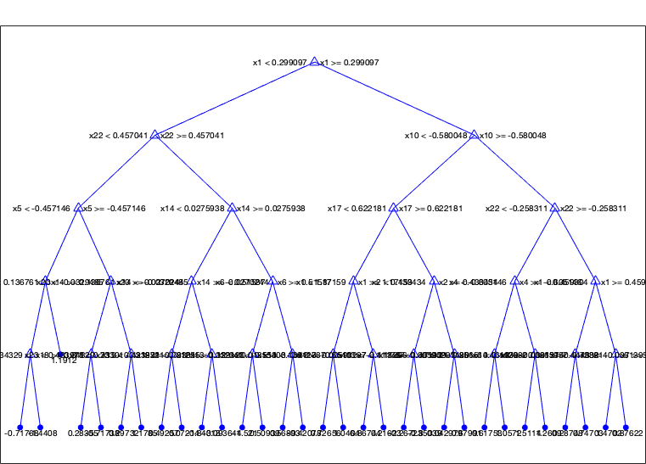
Regression Trees
Notes:
Make a split on the variable that maximize difference in MSE before and after the split.
Performed optimization of minimum number of leaves

Slide 47
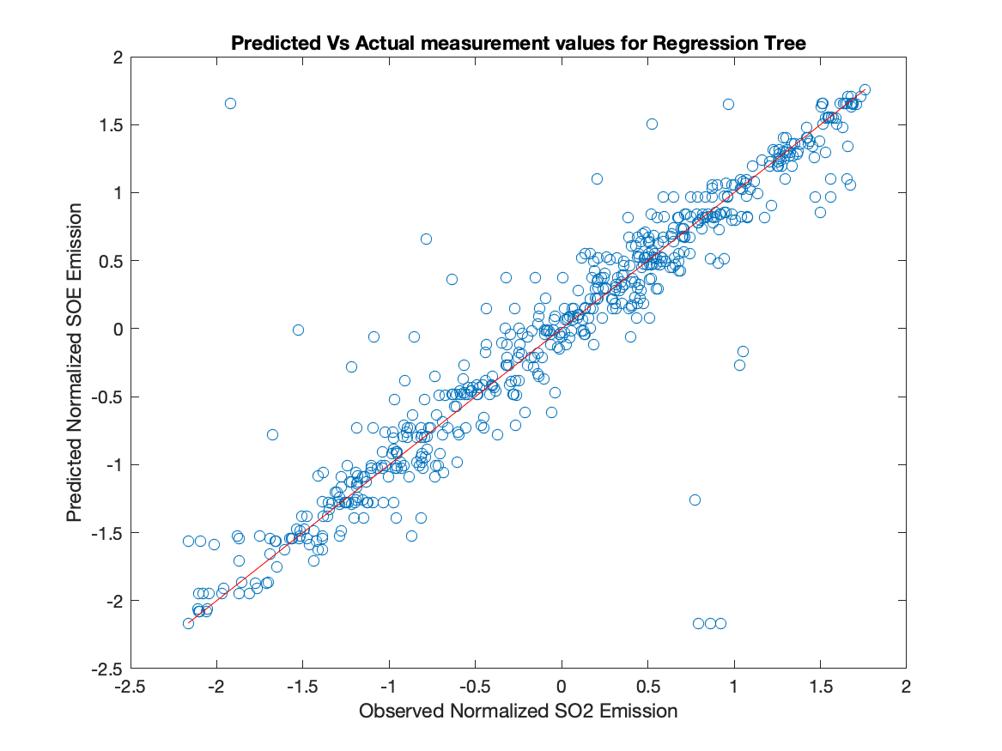
Regression Tree Testing
Regression with all variables with unlimited branches and 10 fold cross validation.
SSE = 81.5320
RMSE = 0.3812
R sq = 0.8583

Slide 48
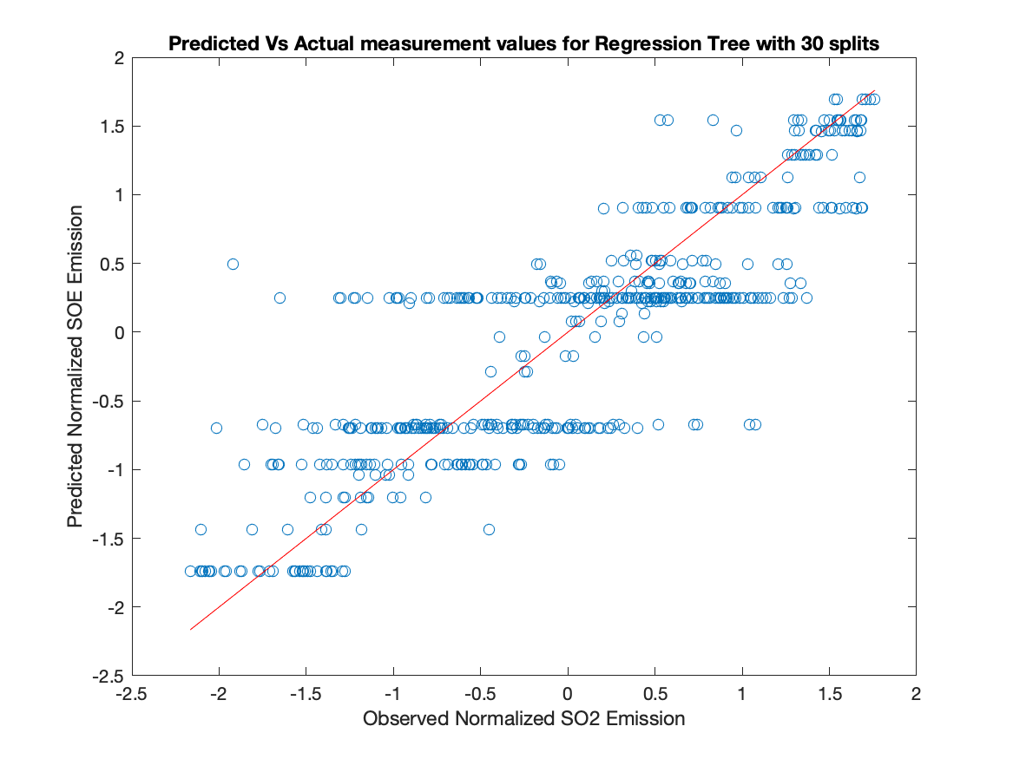
Regression Tree Testing
With 30 splits only, 10 fold cross validation, and all variables
SSE = 150.8188
RMSE = 0.5126
R sq = 0.7379

Slide 49
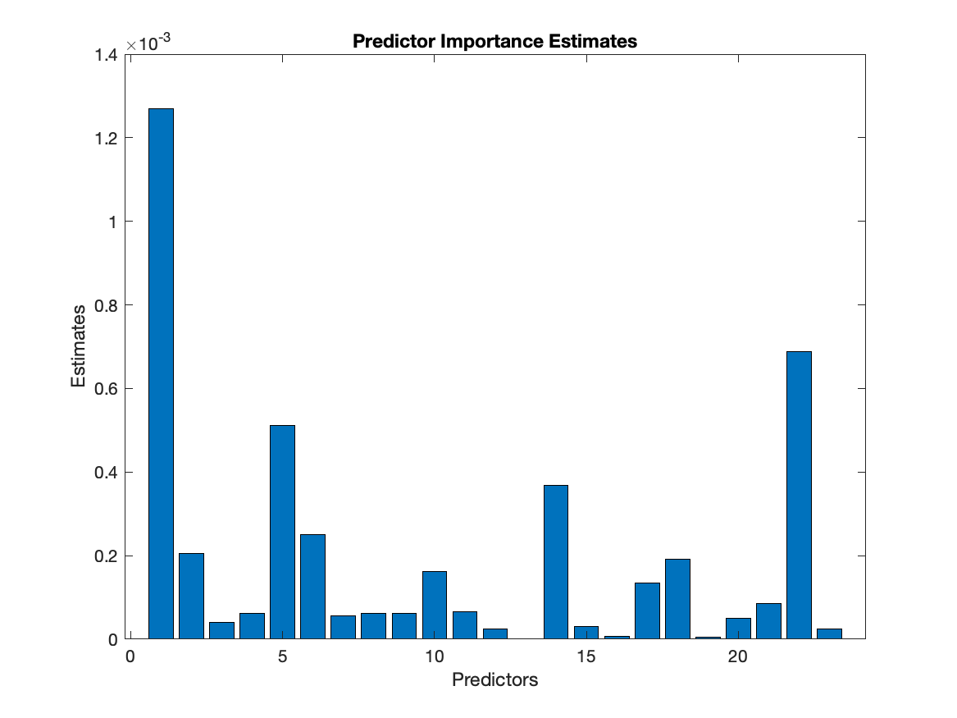
Regression Tree Importance of parameters

Slide 50
Summary of Method Prediction Performance
Method | RMSE | R square | number of variables/ components/ split for trees
OLS | 0.6512 | 0.5866 | 23
LASSO | 0.6695 | 0.5623 | 22
PCR | 0.6512 | 0.5866 | 23
PCR | 0.7369 | 0.4706 | 10
PLS | 0.6699 | 0.5524 | 10
Regression Trees | 0.3669 | 0.8583 | max
Regression Trees | 0.5056 | 0.7451 | 30

Slide 51
Root Cause Analysis Top 6 Variables in beta magnitude
 | OLS Beta | PCR Beta | PLS Beta with 10 component | Decision Tree
Intercept |  | -0.0033 | -0.002
Primary Air Flow | 0.13 | 0.1338 | 0.1736 | 1.25E-03
Secondary Air Flow | 0.48 | 0.4791 | 0.3014 | 8.33E-05
Tertiary Air Flow | -0.09 | -0.0891 | -0.106 | 1.24E-05
Primary Windbox Pressure | 0.01 | 0.0063 | 0.0692 | 4.35E-05
Secondary Windbox Pressure | 0.16 | 0.1629 | 0.1517 | 4.62E-04
Tertiarary Windbox Pressure | 0.23 | 0.2291 | 0.2278 | 2.92E-04
Burn Rate | -0.05 | -0.0517 | -0.2344 | 1.10E-05
White Liquor Sulfidity | -1.15 | -1.1528 | -0.2019 | 3.55E-05
Black Liquor Solid 50./50 Test | -0.56 | -0.5635 | -0.5889 | 1.15E-04
Flue Gas Oxygen | -0.14 | -0.1381 | -0.2517 | 6.98E-05
Total Reduced Sulfur | 0.11 | 0.1131 | 0.1305 | 5.07E-05
Dry Solid Density Transmitter A | 0.04 | 0.0446 | 0.2063 | 1.25E-05
Dry Solid Density Transmitter B | 0.32 | 0.3174 | -0.0241 | 1.12E-05
Primary Air Temperature | -1.88 | -1.8789 | -0.6623 | 4.04E-04
Secondary Air Temperature | 1.91 | 1.9104 | 0.7832 | 6.65E-05
Steam Flow Rate | 0.14 | 0.1429 | 0.103 | 1.87E-05
Black Liquor Solid Flow Rate | -0.19 | -0.1942 | -0.0042 | 8.37E-05
Steam to Dry Solid Ratio | 0.28 | 0.2757 | 0.3191 | 1.62E-04
Black Liquor Pressure | -0.07 | -0.0679 | 0.0106 | 4.80E-05
Black Liquor Indirect Heater Temperature | 1.15 | 1.1518 | 0.1438 | 1.75E-04
Salt Cake Rotary Feeder Speed | 0.16 | 0.163 | 0.1107 | 7.59E-07
Lime Kiln Green Liquor Sulfidity | -0.4 | -0.3978 | -0.3204 | 7.19E-04
Nitrogen Oxides correlation | 0.02 | 0.0184 | 0.0697 | 1.39E-04

Slide 52
Root Cause Analysis
 | Spectral Analysis | Regression | REACHABILITY
Primary Air Flow |  | Yes
Secondary Air Flow | Yes | Yes | Yes
Tertiary Air Flow
Primary Windbox Pressure
Secondary Windbox Pressure
Tertiarary Windbox Pressure
Burn Rate
White Liquor Sulfidity | Yes | Yes | Yes
Black Liquor Solid 50./50 Test |  | Yes
Flue Gas Oxygen | Yes
Total Reduced Sulfur
Dry Solid Density Transmitter A | Yes
Dry Solid Density Transmitter B | Yes
Primary Air Temperature | Yes | Yes | Yes
Secondary Air Temperature | Yes | Yes | Yes
Steam Flow Rate
Black Liquor Solid Flow Rate
Steam to Dry Solid Ratio
Black Liquor Pressure | Yes
Black Liquor Indirect Heater Temperature | Yes | Yes | Yes
Salt Cake Rotary Feeder Speed
Lime Kiln Green Liquor Sulfidity | Yes | Yes
Nitrogen Oxides correlation

Slide 53
Conclusion
Primary air temperature is the root cause of SO2 emission
Regression tree has the highest accuracy in predicting SO2 emission from data
Emission can be reduced if the mill increase primary air temperature and lower black liquor indirect heat temperature
There is no oscillation in SO2 emission in the data provided.

Slide 54
Next Step
Sensitivity analysis on moving average filter window size
Random forest maybe able to give better insights into importance of parameters
Convert normalized prediction back to its units

